Slide 1
Inside the USPTO
Peggy Focarino
Senior Patent Advisor

Slide 2
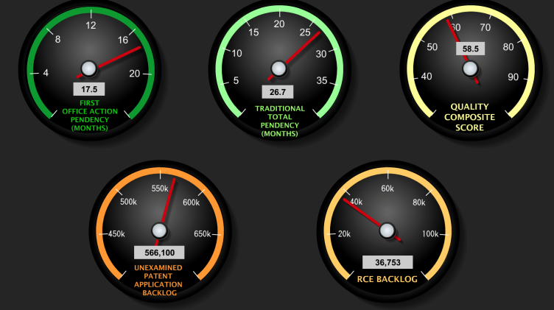
Current PTO Landscape
Three Game-Changers
Reduced patent application backlog
Reduced patent application pendency
A sustainable funding model

Slide 3
Patent Application Backlog

Slide 4
Patent Application Pendency

Slide 5
Budget Update
AIA gave USPTO Director authorization to set/adjust fees to recover aggregate costs
USPTO collected an additional $1.1 billion of patent fees during 2013 – 2015 than it would have without fee setting authority

Slide 6
Budget Update
USPTO Operating reserve increased by $300 million – allowing for continued operation of Agency during FY ‘2014 gov’t shutdown and investment in IT improvements in FY ‘2015 (in spite of lower than anticipated patent application filings and nearly $100 million less in associated fee revenue)

Slide 7
Budget Update
USPTO is currently evaluating proposals and conducting analysis on potential fee adjustments
Decision expected this fall
AIA fee setting authority sunsets Sept.16, 2018
USPTO recommendation to Congress is to make fee setting authority permanent

Slide 8
User Fees Withheld from the USPTO
(1991 -2013)

Slide 9
Changes → New PTO Initiatives
Focus on Compact Prosecution
Enhanced Patent Quality Initiative
Improving Global Patent Prosecution

Slide 10
Compact Prosecution Initiatives

Slide 11
Interviews
What’s different
-Shifting attitudes of examiners toward
conducting interviews
-PTO emphasis on applicant
collaboration during examination
What’s in it for me
-High quality patents
-Fewer actions/disposal = reduced costs

Slide 12
Interview Survey Results
How often do clarification or better understanding of positions occur during an interview?
- Applicant: 97.6% of the time
- Examiner: 95% of the time
*Based upon USPTO 2014 interview Survey

Slide 13
Interview Survey Results
How often does a better understanding of the claimed invention occur during an interview?
- Applicant: 93.5% of the time
- Examiner: 83.7% of the time

Slide 14
Interview Survey Results
How often reaching an agreement or advancing prosecution occurs during an interview?
- Applicant: 81.1% of the time
- Examiner: 92.6% of the time

Slide 15
Interview Impacts on Quality

Slide 16
Proposed Quality Initiatives
I. Excellence in work products
1. Applicant requests prosecution review of selected
applications
2. Automated pre-examination search
3. Clarity of the record
II. Excellence in measuring patent quality
1. Review/improvements to quality metrics
III. Excellence in customer service
1. Review of current compact prosecution model and effect on quality
2. In-person interview capability with all examiners

Slide 17
Improving Global Patent
Prosecution
Global Dossier
Collaborative Search Pilot
Global Preliminary Search Concept

Slide 18
What’s Next
Heavy focus/increased resources toward examination quality
Fee changes to counter decrease in patent application filings (is this the “new normal”?)
Leveraging access to IP5+ patent family dossiers

Slide 19
What’s Next
???
Patent Reform
Court decisions on subject matter eligibility

Slide 20
Thank You
Questions?
margaret.focarino@oblon.com

